Slide 1
BT209 Bioreaction Engineering
10/03/2022

Slide 2

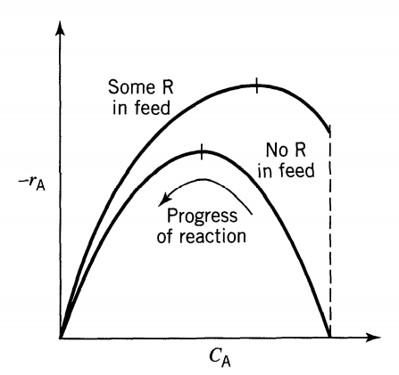
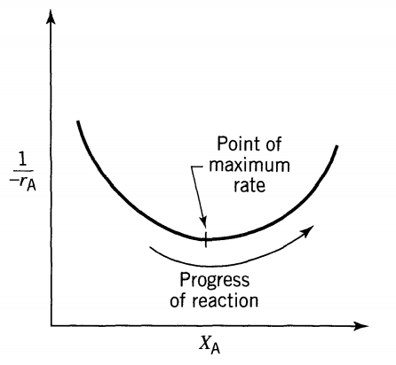

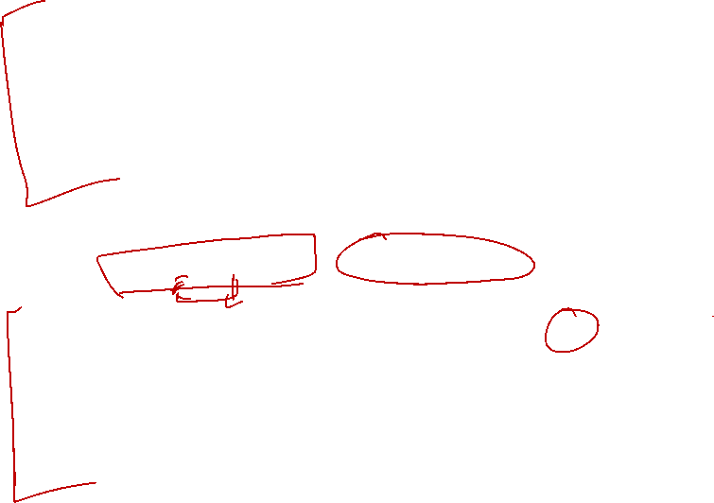

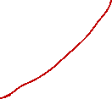

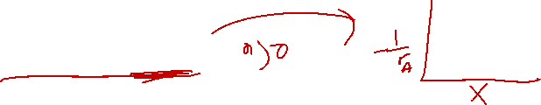






Autocatalytic reaction and reactor
nth order reaction (n>0) A→R
When a material reacts away (A→R) by any nth order rate (n > 0) in a batch reactor, its rate of disappearance is rapid at the start when the concentration of reactant is high. This rate then slows progressively as reactant is consumed.
Reactions with such rate-concentration curves lead to interesting optimization problems
Autocatalytic reaction
In an autocatalytic reaction, however, the rate at the start is low because little product is present; it increases to a maximum as product is formed and then drops again to a low value as reactant is consumed. Figure 6.18 shows a typical situation.

Slide 3
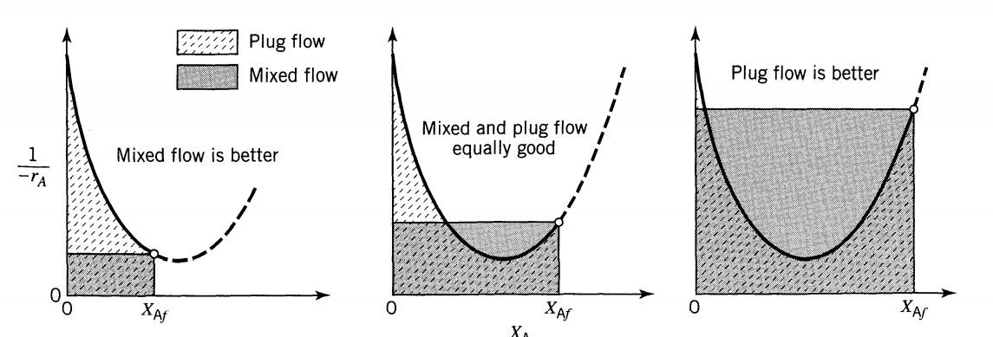








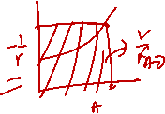
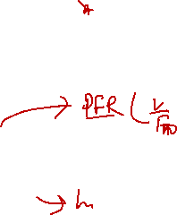
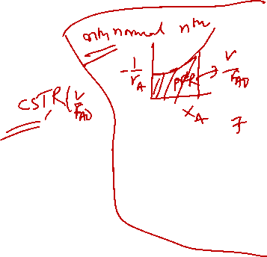









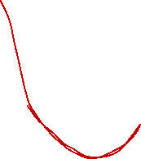
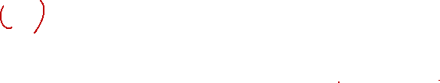




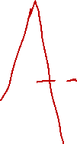





Plug Flow Versus Mixed Flow Reactor, No Recycle
For any particular rate-concentration curve a comparison of areas in Fig. will show which reactor is superior (which requires a smaller volume) for a given job.
At low conversion the mixed reactor is superior to the plug flow reactor.
At high enough conversions the plug flow reactor is superior.
For autocatalytic reactions mixed flow is more efficient at low conversions, plug flow is more efficient at high conversions.

Slide 4
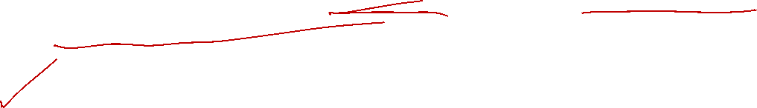




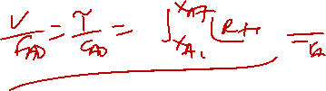

Cont..
These findings differ from ordinary nth-order reactions (n > 0) where the plug flow reactor is always more efficient than the mixed flow reactor.
In addition, we should note that a plug flow reactor will not operate at all with a feed of pure reactant. In such a situation the feed must be continually primed with product, an ideal opportunity for using a recycle reactor.
Using optimization problems we can find the optimum recycle ratio which gives the minimum reactor volume or minimum space time
x_{A0}
F_{A0}
C_{A0}
v_{o}
x_{Af}
F_{Af}
C_{Af}
v_{f}

Slide 5





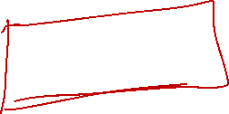
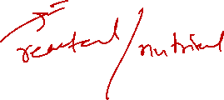






Occurrence of Autocatalytic Reactions
The most important examples of autocatalytic reactions are the broad class of fermentation
reactions which result from the reaction of microorganism on an organic feed.
When they can be treated as single reactions, the methods of this chapter can be applied
directly.
S+ Cell → More cell

Slide 6

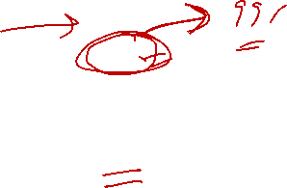






Optimum Recycle Operations
When material is to be processed to some fixed final conversion X_{Af} in a recycle reactor, reflection suggests that there must be a particular recycle ratio (R) which is optimum in that it minimizes the reactor volume or space-time.
x_{A0}
F_{A0}
C_{A0}
v_{o}
x_{A1} (x_{Ai})
F_{A1}
C_{A1}
v₁
x_{A2}
F_{A2}
C_{A2}
v₂
x_{Af}
F_{Af}
C_{Af}
v_{f}
x_{A3}
F_{A3}
C_{A3}
v₃

Slide 7
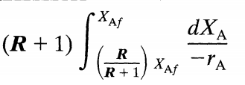


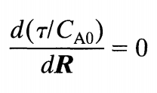


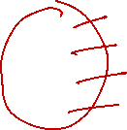

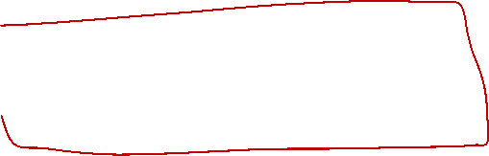
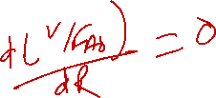




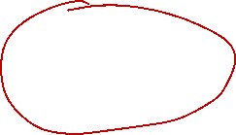
Cont.
x_{A0}
F_{A0}
C_{A0}
v_{o}
x_{A1} (x_{Ai})
F_{A1}
C_{A1}
v₁
x_{A2}
F_{A2}
C_{A2}
v₂
F_{A}
dV
F_{A}+dF_{A}
x_{Af}
F_{Af}
C_{Af}
v_{f}
x_{A3}
F_{A3}
C_{A3}
v₃
The optimum recycle ratio is found by differentiating Eq. with respect to R and setting to zero, thus

Slide 8






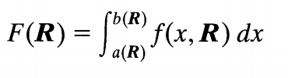
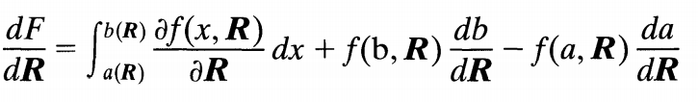
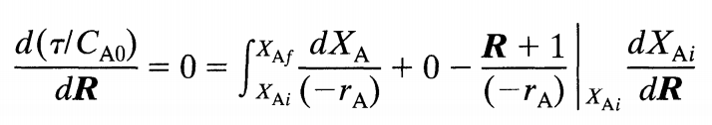


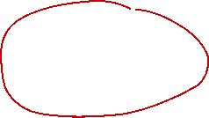




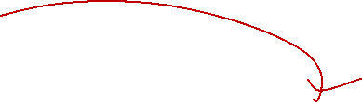
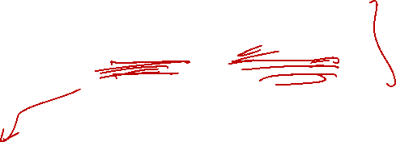


Cont.
for

Slide 9
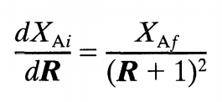

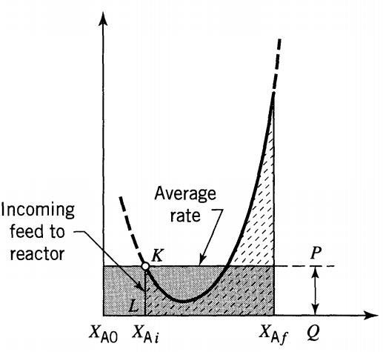
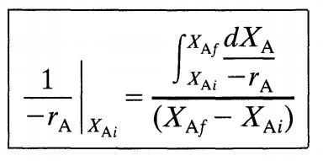

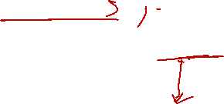





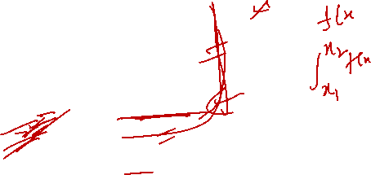

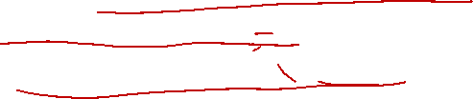





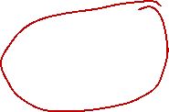


Cont.
x_{A0}
F_{A0}
C_{A0}
v_{o}
x_{A1} (x_{Ai})
F_{A1}
C_{A1}
v₁
x_{A2}
F_{A2}
C_{A2}
v₂
x_{Af}
F_{Af}
C_{Af}
v_{f}
x_{A3}
F_{A3}
C_{A3}
v₃
In words, the optimum recycle ratio introduces to the reactor a feed whose 1/(-r_{A}) value (KL in Fig.) equals the average 1/(-r_{A}) value in the reactor as a whole (PQ in Fig.).

Slide 10
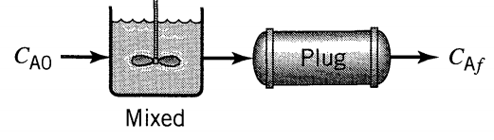
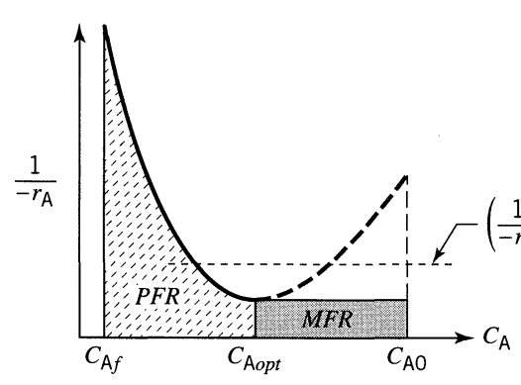



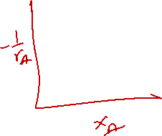








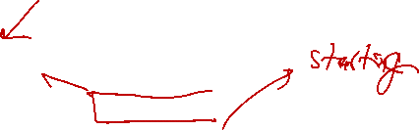

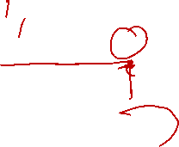
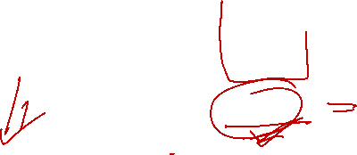


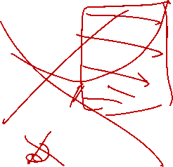

Reactor combination for autocatalytic reaction with out recycle
For autocatalytic reactions
In general, for a rate-concentration curve as shown in Fig one should always try to reach point M in one step (using mixed flow in a single reactor), then follow with plug flow or as close to plug flow as possible. This procedure is shown as the shaded area in Fig.
X_{A0}=0
X_{Aopt}
X_{Af}
MFR
PFR
X_{A0}=0
X_{Aopt}
X_{Af}

